Slide 1

Monolith vs Microservice Software Architectures
Henry okwudili

Slide 2
Understanding The Architectures
Definition
Components
Advantages
Disadvantages
Examples

Slide 3
Monolithic Software Architectures
Single unified unit
Database
Client-side user interface
Server-side application

Slide 4
Components
Single codebase
User authentication
Business logic
Data access
Etc.

Slide 5
Advantages
Simple to develop, test and deploy.
Implements direct method calls.
Running and debugging of the application can be done in one go.

Slide 6
Disadvantages
Difficult to manage and scale.
Changes in the codebase can affect the entire system.

Slide 7
Example
A monolithic architecture is a traditional e-commerce platform where all functionality, from user management to order processing, is contained within a single codebase.

Slide 8
Microservices Software Architectures
Loosely coupled services
Independently deployable
Scalable
Interacts with other services through apis

Slide 9
Components
Single business capability
Services are developed;
Deployed &
Scaled independently

Slide 10
Advantages
Flexibility in choosing technology stacks.
Independent scaling.
Improve fault isolation.
Faster development and deployment cycles.

Slide 11
Disadvantages
Complex inter-service communication.
Complex data consistency.
Complex overall system management.
Difficulty monitoring and debugging distributed systems.
Complex Deployment.

Slide 12
Example
An online streaming platform with a microservices architecture is an example of a platform where separate services handle user management, content delivery, recommendation algorithms, and payment processing.

Slide 13
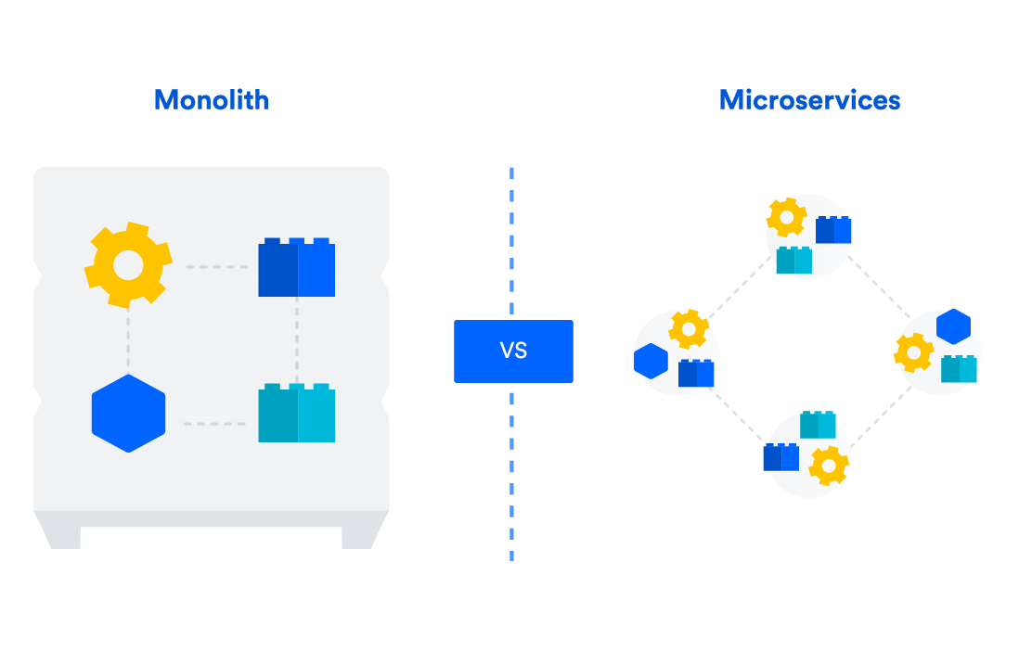

Slide 14
Key Considerations
 | Monolithic Architecrures | Microservice Architectures
Size & complexity of the project | Suitable for small to medium-sized projects | Appropriate for large, complex, and evolving project
Team structure | Small | Large
Technology stack | Single technology stack | Different technology stack for each service.
Deployment and maintenance | Easier to deploy initially, | Offer more streamlined continuous deployment and updates

Slide 15
Conclusion
Choice should be guided by
Project’s Requirement
Team size & structure
Long-term maintenance and scalability goals
a hybrid approach might be the best solution.

Slide 16
Thank You!!!
References:
Microservices Architecture: https://www.secondfront.com/glossary/microservices-architecture
Monolith vs Microservices: Choosing Wisely | Startup House. https://startup-house.com/blog/monolith-vs-microservices-architecture
Microservices vs. monolithic architecture: https://www.atlassian.com/microservices/microservices-architecture/microservices-vs-monolith

